Slide 1
ADVANCED DATABASE ADMINISTRATION
Database User Security
Managing Schema Objects
Managing Data And Concurrency
UNIT-2
By Jasleen Kaur
GTBIT (IT Dept.)

Slide 2
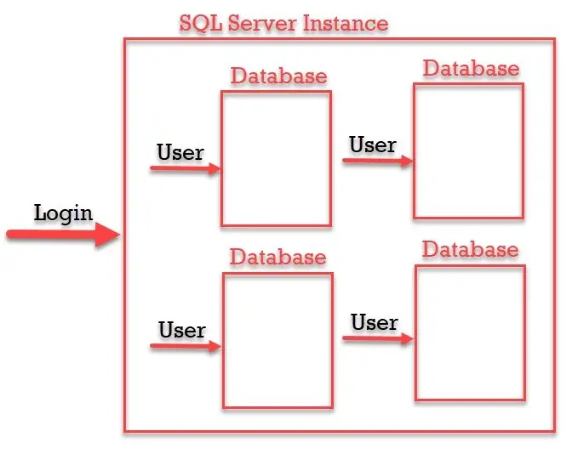
DATABASE USER SECURITY
Creating a New User Account- You create a database user with the CREATE USER statement
Because it is a powerful privilege, a database administrator or security administrator is usually the only user who has the CREATE USER system privilege.
Creates a user and specifies the user password, default tablespace, temporary tablespace where temporary segments are created, tablespace quotas, and profile

Slide 3
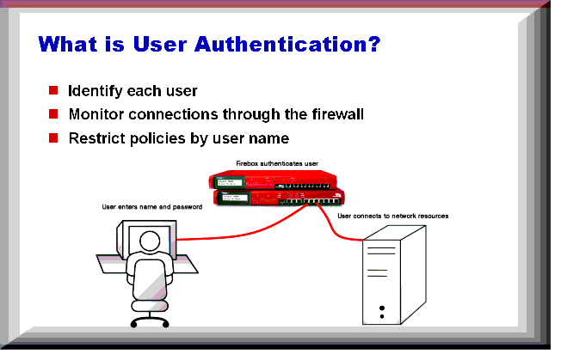
Authenticating User
Authentication means verifying the identity of someone (a user, device, or other entity) who wants to use data, resources, or applications.
Validating that identity establishes a trust relationship for further interactions
Authentication also enables accountability by making it possible to link access and actions to specific identities.
After authentication, authorization processes can allow or limit the levels of access and action permitted to that entity.
Oracle Database requires special authentication procedures for database administrators, because they perform special database operations.
Oracle Database also encrypts passwords
during transmission to ensure the security
of network authentication.

Slide 4
How user authentication works
In order to gain access, users must prove to the website that they are who they say they are.
The ID and key are enough to confirm the user’s identity, which will allow the system to authorize the user.
It’s important to note that authorization, on the other hand, is what dictates what users are able to see and do when they log in.
While authorization and authentication are often used interchangeably, the two different terms work together to create a secure login process.
To put it simply, user authentication has three tasks:
Manage the connection between the human (user) and the website’s server (computer).
Verify users’ identities.
Approve (or decline) the authentication so the system can move to authorizing the user.
The process is fairly simple; users input their credentials on the website’s login form. That information is then sent to the authentication server where the information is compared with all the user credentials on file.
When a match is found, the system will authenticate users and grant them access to their accounts.

Slide 5
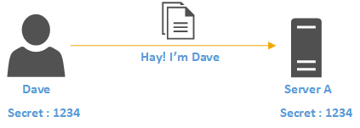
If a match isn’t found, users will be prompted to re-enter their credentials and try again.
After several unsuccessful attempts, the account may be flagged for suspicious activity or require alternative authentication methods such as a password reset or a one time password.

Slide 6
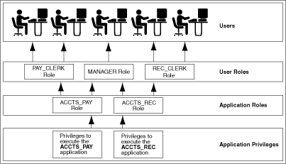
Privileges and Roles
Authorization includes primarily two processes:
• Permitting only certain users to access, process, or alter data.
• Applying varying limitations on user access or actions. The limitations placed on users can apply to objects such as schemas, tables, or rows or to resources such as time.
A user privilege is the right to run a particular type of SQL statement, or the right to access an object that belongs to another user, run a PL/SQL package.
Roles are created by users (usually administrators) to group together privileges or other roles. They are a way to facilitate the granting of multiple privileges or roles to users.
User roles groups several privileges and roles, so that
they can be granted to and revoked from users
simultaneously. You must enable the role for a user
before the user can use it.

Slide 7
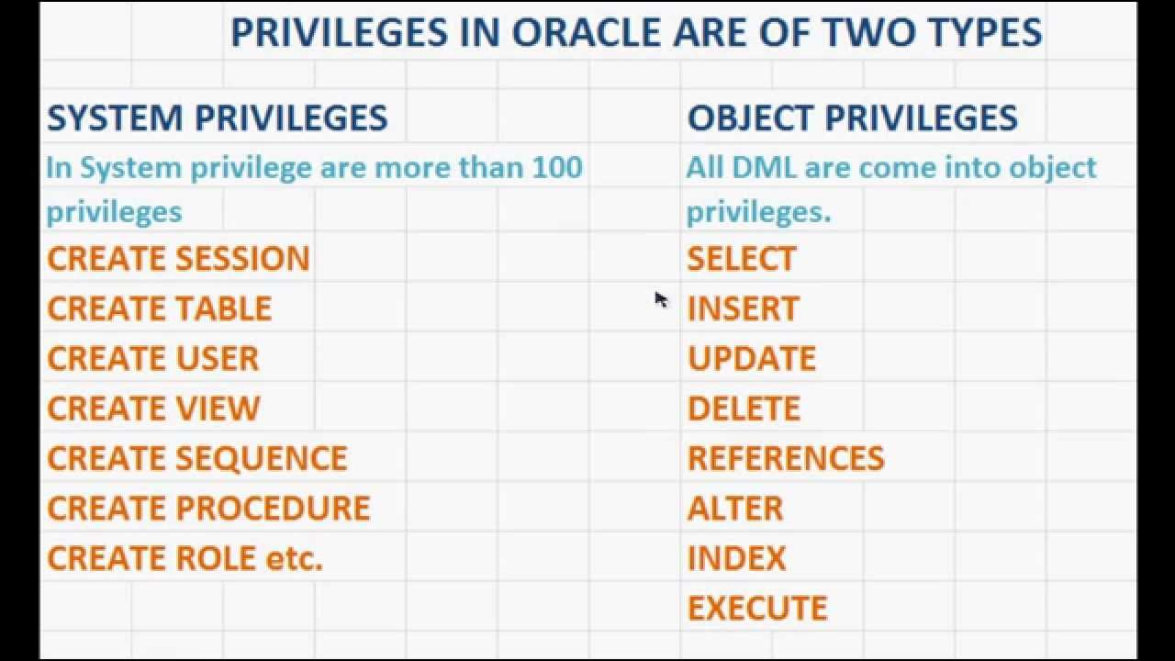
The types of privileges are defined by Oracle Database:
System privileges- These privileges allow to perform standard administrator tasks in the database. Restrict them only to trusted users. For example, the privileges to create tablespaces and to delete the rows of any table in a database are system privileges.
Because system privileges are so powerful, by default the data base is configured to prevent typical(non-administrative) users from exercising the ANY system privileges (such as UPDATE ANY TABLE) on the data dictionary
Object privileges- An object privilege is a right that you grant to a user on a database object. Each type of object has privileges associated with it.
An object privilege is a right that you grant to a user on a database object. Some examples of object privileges include the right to:
Use an edition
Update a table
Select rows from another user’s table
Execute a stored procedure of another user

Slide 8
Granting Object Privileges
• Grants the SELECT, INSERT, and DELETE object privileges for all columns of the emp table to the user jfee.
GRANT SELECT, INSERT, DELETE ON emp TO jfee;
• Grant all object privileges on the salary view to user jfee, use the ALL keyword as shown in the following example:
GRANT ALL ON salary TO jfee;

Slide 9
MANAGING SCHEMA OBJECT
As a database administrator (DBA), you can create, modify, and delete schema objects in your own schema and in any other schema. A database administrator is defined as any user who is granted the DBA role.
Table Types
The table is the basic unit of data storage in an Oracle database. It holds all user accessible data. Each table is made up of columns and rows.
The most common type of table in an Oracle database is a RELATIONAL TABLE, which is structured with simple columns. Two other table types are supported: OBJECT TABLES and XML TYPE TABLES. Any of the three table types can be defined as permanent or temporary.
Temporary tables hold session-private data that exists only for the duration of a transaction or session. They are useful in applications where a results set must be held temporarily in memory
You can build relational tables in either heap or index-organized structures.
In heap structures, the rows are not stored in any particular order.
In index-organized tables, the row order is determined by the values in one or more selected columns

Slide 10
Actions with Table
Creating Tables: To create a new table in your schema, you must have the CREATE TABLE system privilege. To create a table in another user’s schema, you must have the CREATE ANY TABLE system privilege.
CREATE TABLE hr.admin_emp(
empno NUMBER(5) PRIMARY KEY,
ename VARCHAR2(15) NOT NULL,
Adding Table Columns:
ALTER TABLE hr.admin_emp
ADD (bonus NUMBER(7,2));
Renaming Table Columns:
ALTER TABLE hr.admin_emp
RENAME COLUMN comm TO commission;
Dropping Table Columns:
ALTER TABLE hr.admin_emp DROP COLUMN sal;
ALTER TABLE hr.admin_emp DROP (bonus, commission);

Slide 11
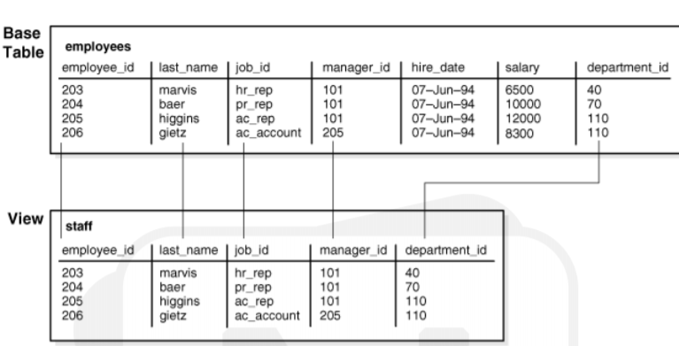
Views
A view is a tailored presentation of the data contained in one or more tables or other views. A view takes the output of a query and treats it as a table.
Therefore, a view can be thought of as a stored query or a virtual table. You can use views in most places where a table can be used
For example, the employees table has several columns and numerous rows of information. If you want users to see only five of these columns or only specific rows, then you can create a view of that table for other users to access.

Slide 12
Sequence Generator
The sequence generator provides a sequential series of numbers. The sequence generator is especially useful in multiuser environments for generating unique sequential numbers
For example, assume two users are simultaneously inserting new employee rows into the employees table. By using a sequence to generate unique employee numbers for the employee_id column, neither user has to wait for the other to enter the next available employee number. The sequence automatically generates the correct values for each user.
A sequence definition indicates general information, such as the following:
• The name of the sequence
• Whether the sequence ascends or descends
• The interval between numbers
• Whether Oracle should cache sets of generated sequence numbers in memory

Slide 13
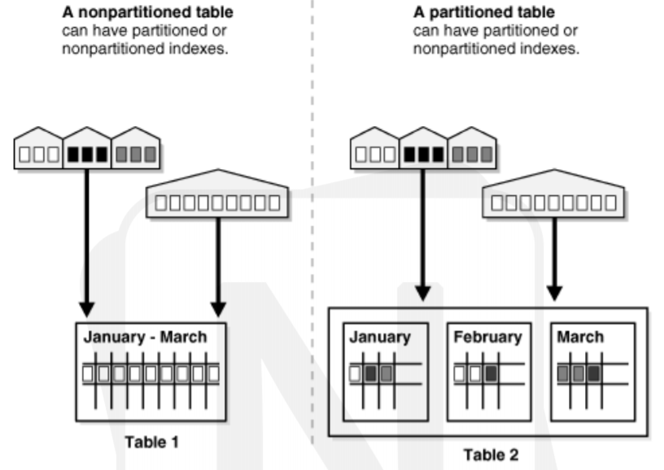
Partitioning
Partitioning enhances the performance, manageability, and availability of a wide variety of applications and helps reduce the total cost of ownership for storing large amounts of data.
Partitioning allows tables, indexes, and index-organized tables to be subdivided into smaller pieces, enabling these database objects to be managed and accessed at a finer level of granularity.
Each partition has its own name, and may optionally have its own storage characteristics.

Slide 14
Benefits of Partitioning
Improve performance, manageability, and availability
Partitioning can greatly simplify common administration tasks.
Partitioning also enables data base designers and administrators to tackle some of the toughest problems

Slide 15
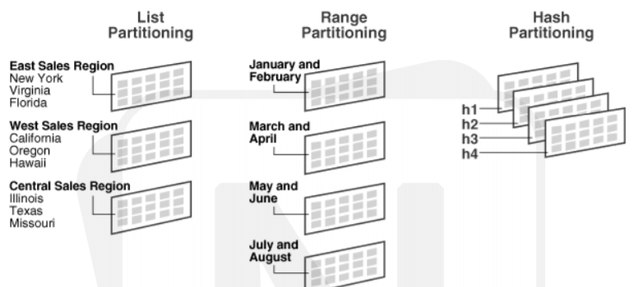
Partitioning Strategies
Levels:
Single-Level Partitioning
Composite Partitioning
Single-Level Partitioning:
Range Partitioning: Range partitioning maps data to partitions based on ranges of values of the partitioning key that you establish for each partition
Hash Partitioning: Hash partitioning maps data to partitions based on a hashing algorithm that Oracle applies to the partitioning key that you identify. The hashing algorithm evenly distributes rows among partitions, giving partitions approximately the same size.
List Partitioning: List partitioning enables you to explicitly control how rows map to partitions by specifying a list of discrete values for the partitioning key in the description for each partition. The advantage of list partitioning is
that you can group and organize
unordered and unrelated sets of
data in a natural way.

Slide 16
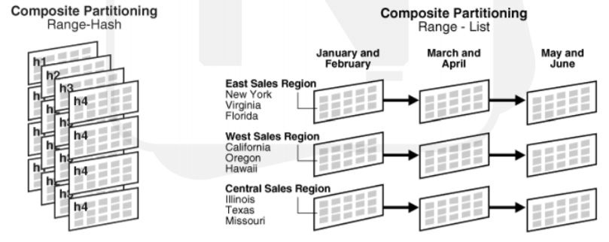
Composite Partitioning
Composite partitioning is a combination of the basic data distribution methods; a table is partitioned by one data distribution method and then each partition is further subdivided into subpartitions using a second data distribution method. All subpartitions for a given partition together represent a logical subset of the data.

Slide 17
Index-Organized Tables
An index-organized table has a storage organization that is a variant of a primary B-tree. Unlike an ordinary (heap-organized) table whose data is stored as an unordered collection(heap), data for an index-organized table is stored in a B-tree index structure in a primary key sorted manner. The structure of an index-organized table provides the following benefits:
Fast random access on the primary key because an index-only scan is sufficient.
Fast range access on the primary key because the rows are clustered in primary key order.
Lower storage requirements because duplication of primary keys is avoided. Index-organized tables have full table functionality. They support features such as constraints, triggers, LOB and object columns, partitioning, parallel operations, online reorganization, and replication. And, they offer these additional features:
Key compression
Overflow storage area and specific column placement
Secondary indexes, including bit map indexes.
Creating an Index-Organized Table
CREATE TABLE admin_docindex(
token char(20),
doc_id NUMBER,
token_frequency NUMBER,

Slide 18
Heap-organized table
A heap-organized table is a table with rows stored in no particular order.
This is a standard Oracle table; the term "heap“ is used to differentiate it from an index-organized table or external table.
If a row is moved with in a heap-organized table, the row’s ROWID will also change.
Examples
CREATE TABLE t1 (c1 NUMBER PRIMARY KEY, c2 VARCHAR2(30));
CREATE TABLE t1 (c1 NUMBER PRIMARY KEY, c2 VARCHAR2(30)) ORGANIZATION HEAP;

Slide 19
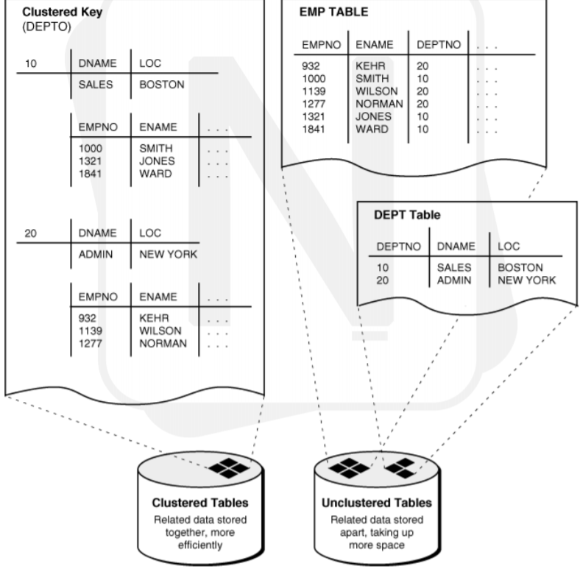
Clusters
A cluster provides an optional method of storing table data.
A cluster is made up of a group of tables that share the same data blocks.
The tables are grouped together because they share common columns and are often used together.
Because clusters store related rows of different tables together in the same data blocks, properly used clusters offer two primary benefits:
Disk I/O is reduced and access time improves for joins of clustered tables.
The cluster key is the column, or
group of columns, that the clustered
tables have in common. You specify the
columns of the cluster key when creating
the cluster. Therefore, less storage might
be required to store related table and
index data in a cluster than is necessary
in non-clustered table format.

Slide 20
Cluster Types
Fail-Over Clusters: emphasis is on complete avoidance of unplanned downtime and achieving higher availability. High-availability clusters allow multiple servers, in conjunction with shared disk storage units, to quickly recover from failures.
Scalable High Performance Clusters: provides scalability, high performance, load balancing, and high availability through the use of parallel middleware. These are also called Parallel Clusters or High Performance Computing Clusters (HPCC).
Application Clusters: Real Application Clusters (Oracle RAC) is a clustered version of Oracle Database based on a comprehensive high-availability stack that can be used as the foundation of a database cloud system as well as a shared infrastructure, ensuring high availability, scalability, and agility for any application.
Network Load balancing clusters: Load balancing is the means by which network traffic directed to a particular Website is divided between one or more machines in a cluster of servers. System performance is optimized, scalability is simplified, and application availability (a key requirement of Web-based applications) is greatly enhanced.

Slide 21
MANAGING DATA AND CONCURRENCY
Manipulating data through sql
SQL language encompasses several categories of statements: statements that work with data, other statements that define and modify the structures (such as tables and indexes) that hold data, and still other statements that control the operation of the database itself.
Statements used to manipulate data:
INSERT
Places new records, or rows, into a database table.
INSERT INTO table_name (column_list) VALUES (value_list);
INSERT INTO employee (employee_id, employee_name); VALUES ('114’,’Jasleen Bhatia’);
SELECT
Retrieves previously inserted rows from a database table.
SELECT * FROM employee;
SELECT employee_id, employee_name, employee_hire_date, employee_termination_date, employee_billing_rate FROM employee;
SELECT employee_id, employee_name FROM employee WHERE employee_id=114;

Slide 22
UPDATE
Modifies data in a table.
UPDATE project
SET project_name = 'Virtual Private Network’,
project_budget = 199999.95
WHERE project_id = 1005;
DELETE
Deletes data from a table.
DELETE FROM project
WHERE project_id>8000;
TRUNCATE TABLE table_name;
MERGE
Brings a table upto date by modifying or inserting rows.

Slide 23
Function
A function is a named PL/SQL Block which is similar to a procedure. The major difference between a procedure and a function is, a function must always return a value, but a procedure may or may not return a value.
Creating a Function
CREATE [OR REPLACE] FUNCTION function_name
[(parameter_name [IN|OUT|IN OUT] type[,...])]
RETURN return_datatype
BEGIN <function_body>
END[function_name];

Slide 24
Procedures
A procedure is a named PL/SQL Block which is similar to a function. The major difference between a procedure and a function is, a function must always return a value, but a procedure may or may not return a value.
Creating a Procedure
CREATE [OR REPLACE] PROCEDURE procedure_name
[(parameter_name[IN|OUT|IN OUT]type[,...])]
BEGIN
<procedure_body>
END procedure_name;

Slide 25
Packages
PL/SQL packages are schema objects that groups logically related PL/SQL types, variables and subprograms.
A package will have two mandatory parts:
Package specification: The specification is the interface to the package. It just DECLARES the types, variables, constants, exceptions, cursors, and subprograms that can be referenced from outside the package. In other words, it contains all information about the content of the package, but excludes the code for the subprograms.
Package body or definition: The package body has the codes for various methods declared in the package specification and other private declarations, which are hidden from code outside the package

Slide 26
Triggers
Triggers are stored programs, which are automatically executed or fired when some events occur. Triggers are, in fact, written to be executed in response to any of the following events:
A database manipulation (DML) statement (DELETE, INSERT, or UPDATE).
A database definition (DDL) statement (CREATE, ALTER, or DROP).
A database operation (SERVER ERROR, LOG ON, LOG OFF, START UP, or SHUTDOWN).
Triggers could be defined on the table, view, schema, or database with which the event is associated.

Slide 27
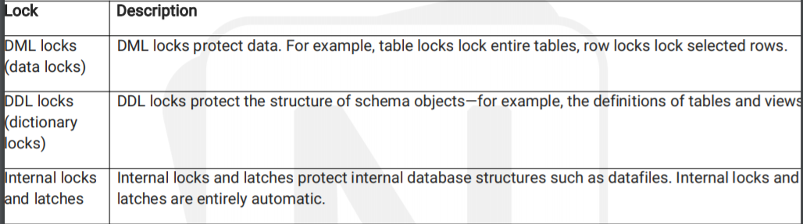
Locking Concept
A lock is a mechanism that prevents destructive interactions, which are interactions that incorrectly update data or incorrectly alter underlying data structures, between transactions accessing shared data.
Locks play a crucial role in maintaining database concurrency and consistency.
In general, the database uses two types of locks: exclusive locks and share locks
Only one exclusive lock can be obtained on a resource such as a row or a table, but many share locks can be obtained on a single resource.
Locks affect the interaction of readers and writers.
The following rules summarize the locking behavior:
A row is locked only when modified by a writer.
A writer of a row blocks a concurrent writer of the same row.
A reader never blocks a writer.
A writer never blocks a reader.

